Slide 1
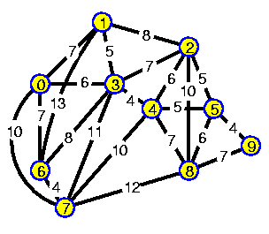
Chapter 11 Weighted Graphs

Slide 2

Outline
Minimum Spanning Tree with Weighted Graphs（Prim & Kruskal）
The Shortest-Path Problem*
The All-Pairs Shortest-Path Problem*
Efficiency
Intractable Problems

Slide 3
In this chapter,we’ll explore graphs with weight.
distances between the cities
The weight of the edges
might represent
costs to fly between cities
the number of automobile trips
Some interesting and complex questions arise:
What is the minimum spanning tree（MST） for a weighted graph?
What is the shortest (or cheapest) distance from one vertex to another?

Slide 4






Minimum Spanning Tree with Weighted Graphs
An Example: Cable TV in the Jungle（Prim算法）
Q：How can we pick a route that minimizes the cost of installing the cable system?
Bordo
Colina
A：To calculate a minimum spanning tree.
10
B
C
6
9
7
A
F
7
5
Ajo
8
7
4
Flor
12
D
E
Danza
Erizo

Slide 5
Minimum Spanning Tree with Weighted Graphs
The GraphW Workshop Applet
Bordo
Colina
10
C
B
6
9
7
A
F
7
5
Ajo
8
7
4
Flor
12
D
E
Danza
Erizo

Slide 6

Minimum Spanning Tree with Weighted Graphs
Send Out the Surveyors（测量员）
假设
你并不知道在Magnaguena的任意两个town之间建造cable的费用.
这些信息需要通过Surveyors来获得。

Slide 7

Starting in Ajo
Ajo–Danza, $4 million
Ajo–Bordo, $6 million
Bordo
Colina
B
C
6
A
F
Ajo
4
4
Flor
D
E
Danza
Erizo

Slide 8
Building the Ajo–Bordo Link
Ajo–Bordo, $6 million
Danza–Bordo, $7 million
Danza–Colina, $8 million
Danza–Erizo, $12 million
Bordo
Colina
B
C
6
A
F
7
8
Ajo
4
Flor
12
D
E
Danza
Erizo
RULE ：From the list, always pick the cheapest edge.

Slide 9
There are three kinds of towns:
1. Towns that have offices and are linked by cable. (In graph terms they’re in the minimum spanning tree.)
2. Towns that aren’t linked yet and have no office, but for which you know the cost to link them to at least one town with an office. We can call these “fringe” towns.
3. Towns you don’t know anything about.

Slide 10
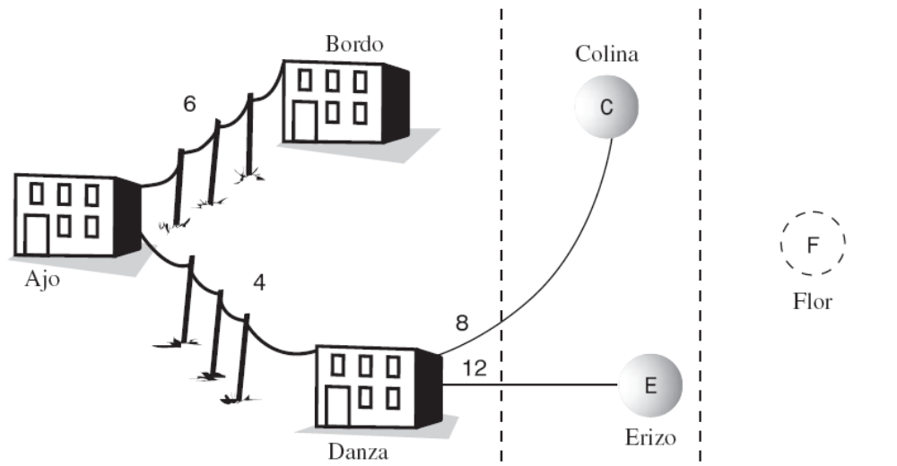
清单上只列出从第一类城镇到达第二类城镇的cable建造费用，而且按从小到大排列。
Towns with offices
(Vertices in the tree)
Fringe Towns
(not in the tree)
Unknown Towns
(not in the tree)

Slide 11
Building the Bordo–Erizo
• Bordo–Erizo, $7 million
• Danza–Colina, $8 million
• Bordo–Colina, $10 million
• Danza–Erizo, $12 million
Bordo
Colina
B
10
C
6
7
A
F
Ajo
8
4
Flor
12
D
E
Danza
Erizo

Slide 12
Building the Erizo–Colina Link
Your new list is
• Erizo–Colina, $5 million
• Erizo–Flor, $7 million
• Danza–Colina, $8 million
• Bordo–Colina, $10 million
The cheapest of these links is Erizo–Colina, so you build this link and install an office in Colina.
B
C
6
7
5
A
F
4
D
E
Danza
Erizo
Finally, the Colina–Flor Link
After you remove already-linked towns, your list now shows only
• Colina–Flor, $6 million
• Erizo–Flor, $7 million
B
C
6
6
7
5
A
F
4
D
E

Slide 13
Minimum Spanning Tree with Weighted Graphs
Creating the Algorithm
在架设电缆的例子中，关键的步骤在于如何维护建造费用表。
借助这个表，我们可以知道选哪条线路来建造（总是选择当前花费最少的那条）。
We repeatedly select the minimum value from the list
The Priority Queue is the solution

Slide 14
Minimum Spanning Tree with Weighted Graphs
Outline of the Algorithm
Start with a vertex, and put it in the tree. Then repeatedly do the following:
1. Find all the edges from the newest vertex to other vertices that aren’t in the tree. Put these edges in the priority queue.
2. Pick the edge with the lowest weight, and add this edge and its destination vertex to the tree.
Repeat these steps until all the vertices are in the tree.
At that point, you’re done.

Slide 15
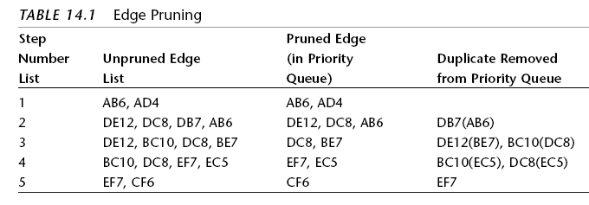
Minimum Spanning Tree with Weighted Graphs
Extraneous Edges（不必要的边）
在维护线路费用表中，需要处理某些线路（链接两个都在tree中城市的），否则会导致重复建设。

Slide 16
Minimum Spanning Tree with Weighted Graphs
Looking for Duplicates in the Priority Queue
How do we make sure there is only one edge per category 2 vertex?
每次我们添加一条表项到队列时，要确保在队列中，没有其他的边也到达同样的终点（非树内的顶点）.
If there is, we keep only the one with the smallest weight.

Slide 17
Minimum Spanning Tree with Weighted Graphs
Java Code
算法通过一个while循环来完成，This loop terminates（中止） when all vertices are in the tree. Within this loop the following activities take place:
1. The current vertex is placed in the tree.
2. The edges adjacent to this vertex are placed in the priority queue (if appropriate).
3. The edge with the minimum weight is removed from the priority queue. The destination vertex of this edge becomes the current vertex.
LISTING 14.1 The mstw.java Program

Slide 18
Kruskal最小生成树算法
算法思想：按Weighted不减的次序生成MST
设G=（V，E）为图，V为顶点集，E为图边集，T是它的MST的边集，n为G中的顶点个数。算法描述如下：
置T为空
while（E不空 && T中边数<n）
{
从E中挑选一条最小边（v，u）；
从E中删除（v，u）；
if（（v，u）加入T中后不产生环）
将（v，u）加入T；
else
舍弃 （v，u）；
}

Slide 19
A
A
1
A
1
4
选出AB
选出ED
1
3
B
B
E
B
E
7
2
5
2
C
D
D
8
选出BE
A
选出AE，作废
A
A
选出BC
1
1
1
3
3
3
B
E
B
E
B
E
5
2
2
2
C
D
D
D

Slide 20
The Shortest-Path Problem
MazeSolverDemo
We want to find the cheapest route from one city to another.
The Railroad Line
Bordo
Colina
$60
B
C
$50
$50
A
$90
$40
Ajo
$80
$20
D
E
$70
Danza
Erizo

Slide 21
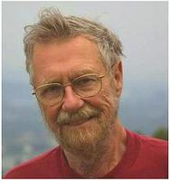
The Shortest-Path Problem
Dijkstra’s Algorithm
It is based on the adjacency matrix representation of a graph.
Edsger Wybe Dijkstra
It finds not only the shortest path from one specified vertex to another, but also the shortest paths
from the specified vertex to all the other vertices.

Slide 22
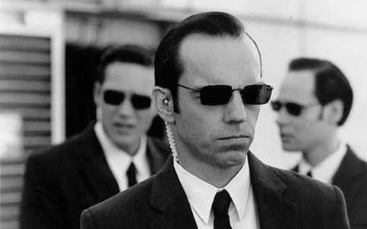


The Shortest-Path Problem
Agents and Train Rides
You hire various agents to find the cheapest way to travel from Ajo to all other towns
当你到达每个集镇,镇上的车站站长会告诉你到邻近几个集镇的车费，但如果你问他到其他集镇（需中转才能到达）的车费，他也不知道。

Slide 23
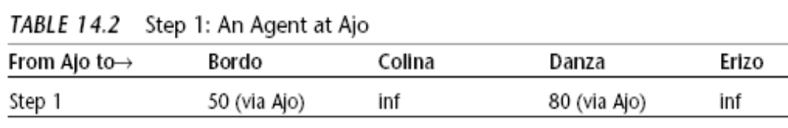
The Shortest-Path Problem
The First Agent: In Ajo
The entry “inf” is short for “infinity”.
RULE
Always send an agent to the town whose overall fare from the starting point (Ajo) is the cheapest.
总是派遣探子到离起点最近的（可能需要中转）集镇

Slide 24
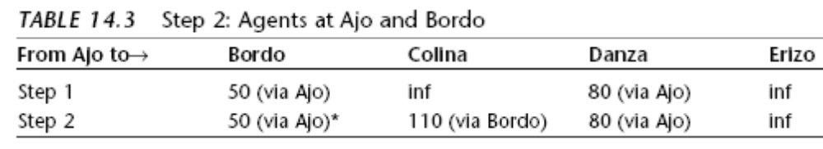
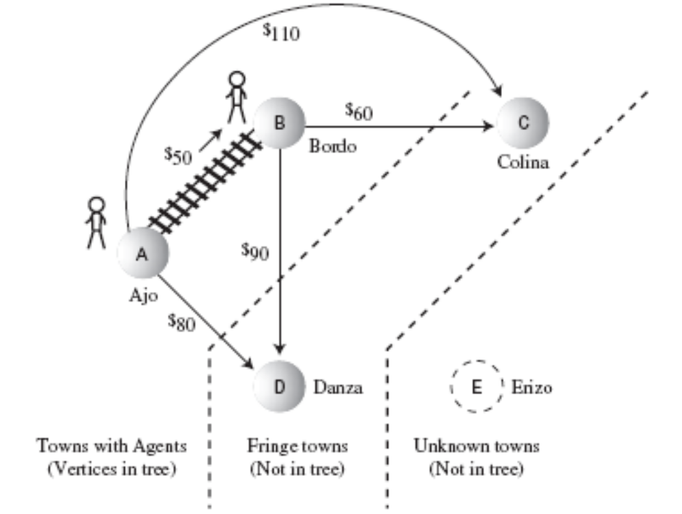
The Second Agent: In Bordo

Slide 25
The Shortest-Path Problem
Three Kinds of Towns
1. Towns in which we’ve installed an agent; they’re in the tree.
2. Towns with known fares from towns with an agent; they’re on the fringe.
3. Unknown towns.

Slide 26
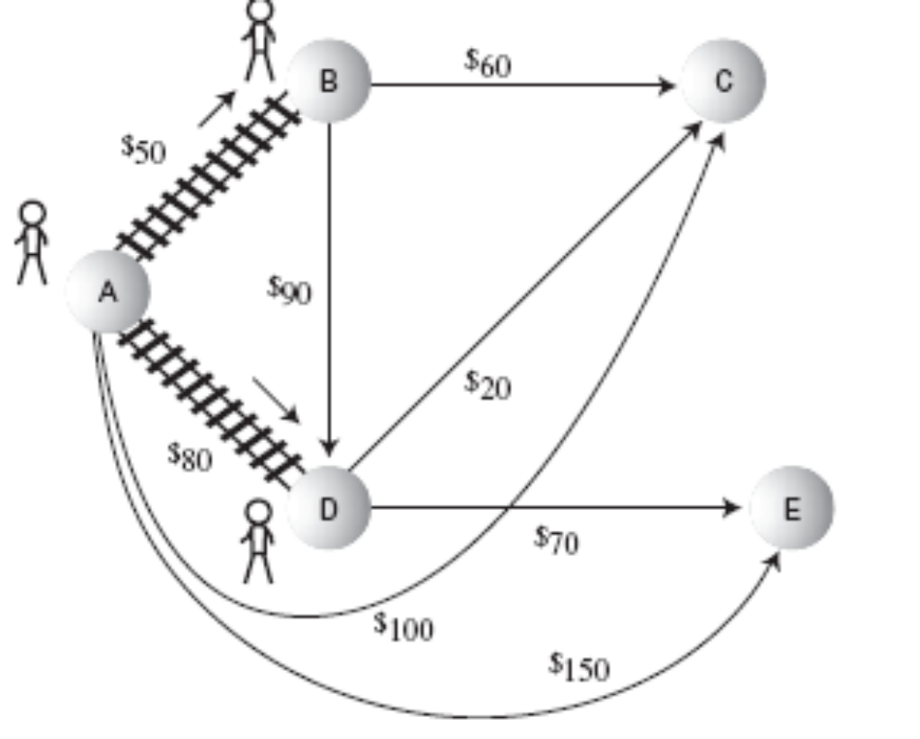
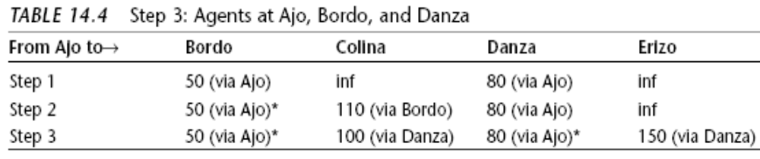
The Third Agent: In Danza
*表示这个town已经有agent，而且表示到它的费用是最低的了。

Slide 27
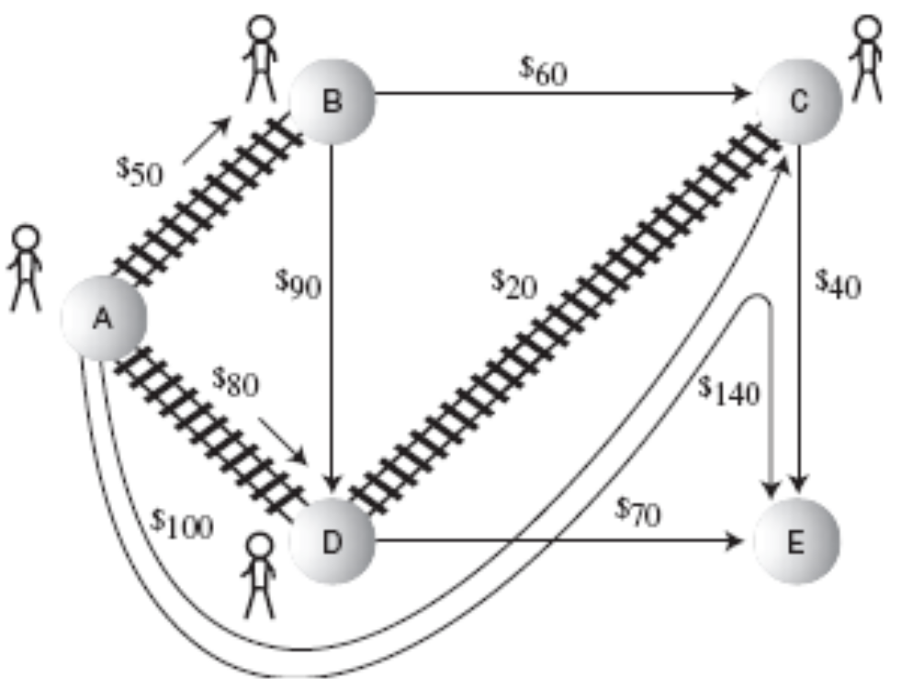
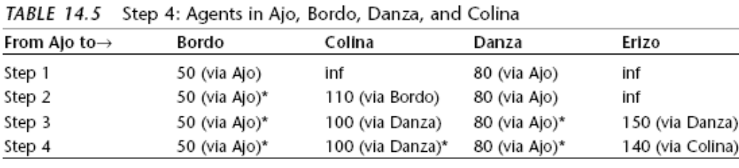
The Fourth Agent: In Colina

Slide 28
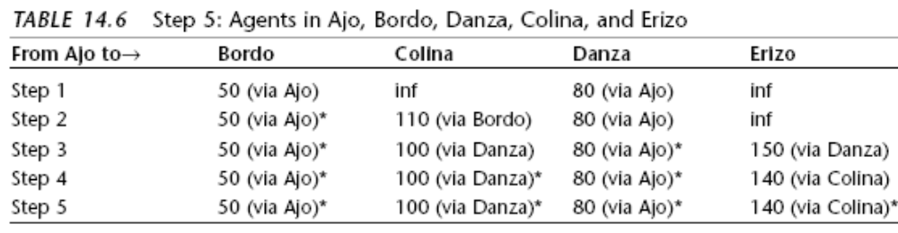
The Shortest-Path Problem
The Last Agent: In Erizo

Slide 29
The Shortest-Path Problem
当每个城市都有代理人后，就知道了Ajo到每个城市的费用。所以要求的工作就完成了。表中的最后一行显示了从Ajo到其他所有城市的费用最低路线。
Dijkstra算法的本质：
每次派一个代理人到新的城市，用这个代理人提供的新信息修正费用表单，在表中只保留从源点到某个城市现在已知的最低费用。
不断向某个新城市派代理人，条件是从源点到那个城市的路线费用最低(并不是从某个有代理人的城市出发的费用最低的路线，那是在最小生成树中用到的。)

Slide 30
The Shortest-Path Problem
Using the GraphDW Workshop Applet

Slide 31
The All-Pairs Shortest-Path Problem
Floyd算法
通过一个图的权值矩阵求出它的每两点间的最短路径矩阵。
从图的邻接矩阵A={a_{ij}} 开始，递归地进行n次更新，即由矩阵D(0)=A，按一个公式，构造出矩阵D(1)；又用同样地公式由D(1)构造出D(2)；……；最后又用同样的公式由D(n-1)构造出矩阵D(n)。矩阵D(n)的i行j列元素便是i号顶点到j号顶点的最短路径长度，称D(n)为图的距离矩阵，同时还可引入一个后继节点矩阵path来记录两点间的最短路径。
采用的是松弛技术，对在i和j之间的所有其他点进行一次松弛。算法的时间复杂度为O(n³);

Slide 32
Efficiency
算法的效率无疑与存储方式相关：
如果Graph使用邻接矩阵方式存储，前面讨论的算法大多需要O（V²），这里V是顶点的数量。为什么?
如果分析这些算法，就发现它们几乎都检查了一遍所有顶点，即在邻接矩阵中扫描每一行，依次查看每一条边。换句话讲，邻接矩阵共有V²个单元，都被扫描过。

Slide 33
Intractable Problems
迄今为止，我们己经看到了大O的值从O(1)，O(N), O(N*logN), O(N²)，一直到Prim算法、Floyd算法（O(N³)）。当O(N³)时间级的问题当N为几千时，也能在可接受的时间内完成。这些复杂度的算法可以用来解决绝大多数实际问题。
然而，有些算法的大O值非常大，以至于只有在N值非常小的时候才有解。许多真实世界需要用这种算法来解决的难题，简直不能在合理的时间内完成。这样的问题称作“Intractable Problems”。(这样的问题有另外一个术语叫做NP完全性，NP的意思是“不确定多项式”。

Slide 34
扩展知识-旅行商问题（TSP）
是一个多局部最优的最优化问题：有n个城市，一个推销员要从其中某一个城市出发，唯一走遍所有的城市，再回到他出发的城市，求最短的路线。
最明显的算法就是穷举法，即寻找一切组合并取其最短。这种算法的排列数为n!(其中n为节点个数)。用动态规划技术，我们可以在 时间内解决此问题。虽然这仍然是指数级的，但要比 快得多。

Slide 35
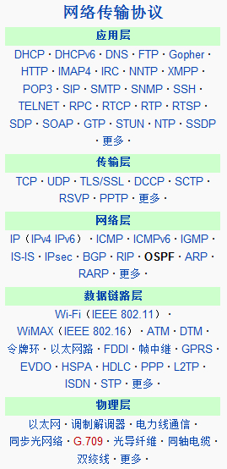
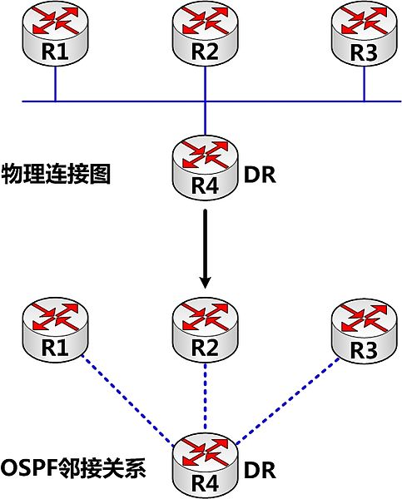
扩展知识：OSPF协议(Open Shortest Path First)
是对链路状态路由协议的一种实现，Dijksta算法用来计算最短路径树。它使用“代价（Cost）”作为路由度量。链路状态数据库（LSDB）用来保存当前网络拓扑结构。

Slide 36
Summary
带权图中，边带有一个数字，叫做权，它可能代表距离、耗费、时间或其他意义。
带权图的最小生成树中有所有的顶点和连接它们的必要的边，且这些边的权值最小。
优先级队列的算法可用于寻找带权图的最小生成树。
带权图的最小生成树模拟了真实世界的许多情况，例如在两城市间铺设线缆。
无权图的最短路径问题要找到两点间的路径，且路径长度最短。

Slide 37
带权图的最短路径问题产生的路径总权值和最小。
带权图的最短路径问题可以用 Dijkstra算法解决。
对于大型的稀疏图，如果用邻接表表示，相对于用邻接矩阵表示，可以提高算法的运行效率。
每一对顶点间的最短路径问题是要找到图中每对顶点间的权值和。Floyd算法用来解决这个问题。
有些图的算法需要指数级时间，因此在顶点多的图中应用不太实际。

Slide 38
The End

